Slide 1
Microprocessors and Microcontrollers
ATMEGA32 CPU Core
Md. Tareq Mahmood
Original slides made by Azad Abdus Salam

Slide 2
ATmega 32
8 bit CMOS microcontroller
RISC architecture (Reduced Instruction Set Computer)
Smaller set of instructions
131 instructions
Mostly Single-Cycle instructions
Approaches throughput of 1MIPS per MHz
MIPS - Million instructions per second

Slide 3
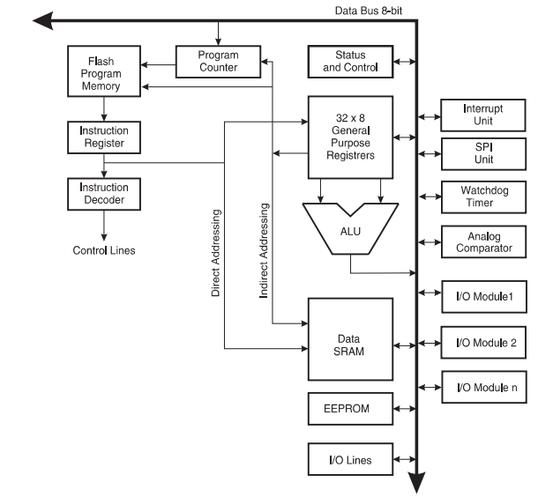
BLOCK DIAGRAM

Slide 4
ATmega 32
Harvard Architecture
Separate memories and buses for program and data
See Harvard and Von Newmann Architecture from Wikipedia
Single Level Pipelining
Next instruction is fetched while the current one is executing

Slide 5
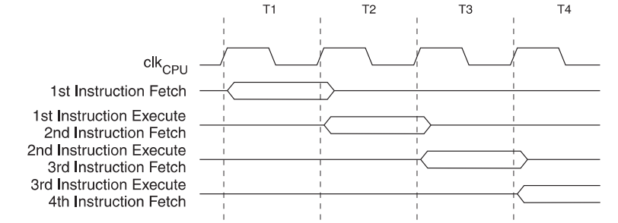
Single Level Pipelining
Single Level Pipelining
Next instruction is fetched while the current one is executing

Slide 6
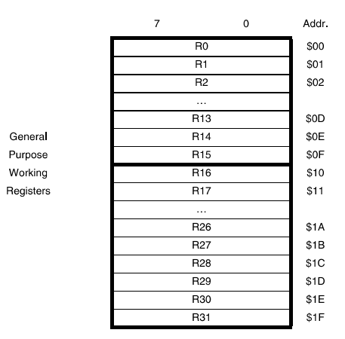
General Purpose Register File
32 general purpose registers
All connected to ALU
This allows two independent registers to be accessed in one clock cycle
Upto two 8-bit/ one 16-bit output operands and result inputs simultaneously

Slide 7
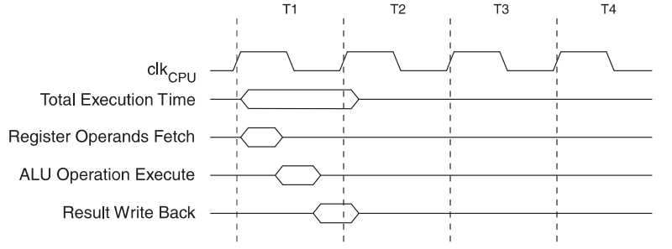
Single Cycle ALU Operation

Slide 8
Interrupt Execution
The interrupt execution response needs four clock cycles minimum.
After four clock cycles the program vector address for the actual interrupt handling routine is executed.
During this four clock cycle period
The Program Counter is pushed onto the Stack.
A jump instruction to the interrupt routine taking three clock cycles.
If an interrupt occurs during execution of a multi-cycle instruction, this instruction is completed before the interrupt is served.

Slide 9
Interrupt Execution
A return from an interrupt handling routine also takes four clock cycles.
During these four clock cycles
Program Counter (two bytes) is popped back from the Stack
the Stack Pointer is incremented by two
the I-bit in SREG is set.

Slide 10
ATmega 32 Memory
Two main memory spaces
the Data Memory
the Program Memory space
ATmega32 also features an EEPROM Memory for data storage.
All three memory spaces are linear and regular

Slide 11
In-System Reprogrammable Flash Memory
32 KB
16 KB in ATmega16
The programs are stored here
Mostly 16 bit instructions, some are 32 bit
Thus Flash Memory is organized as 16K * 16
The Flash Memory is divided in two sections
Boot Program Section
Application Program Section

Slide 12
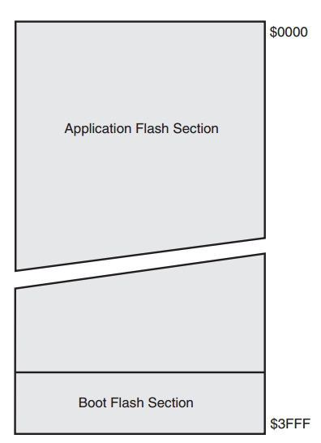
Program Memory Map

Slide 13
Data SRAM
2 KB SRAM
1KB in ATmega16
2144 Data Memory locations
The first 96 locations address the Register File and I/O Memory
32 general purpose registers
64 I/O Registers
The next 2048 locations address the internal data SRAM
ATmega 32 allows five different addressing modes

Slide 14
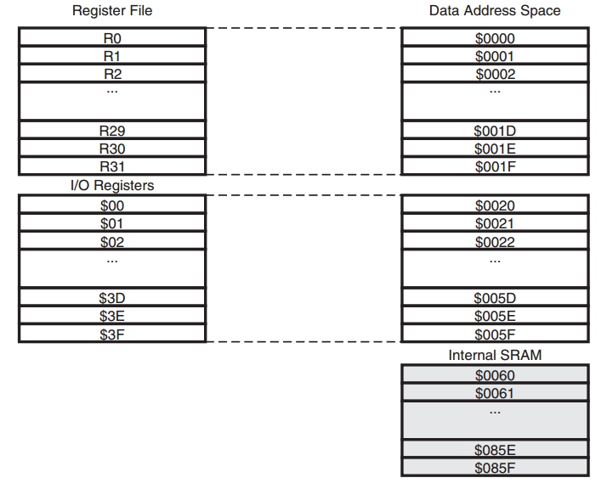
Data Memory Map

Slide 15
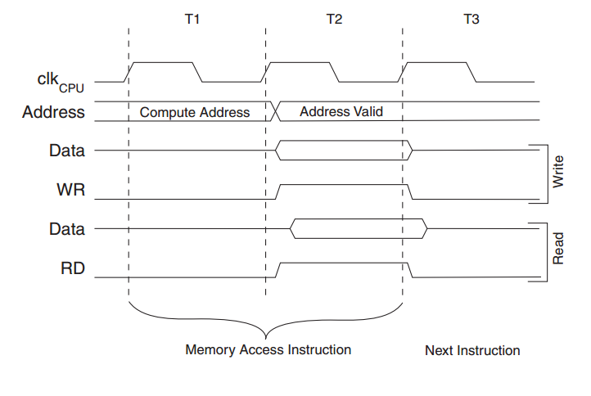
Data SRAM Access Cycles
Two CPU Cycles are needed

Slide 16
EEPROM Electrically Erasable Programmable Read-only Memory

Slide 17
EEPROM Data Memory
1024 bytes of data EEPROM memory
512 bytes in ATmega16
It is organized as a separate data space
Single bytes can be read and written
When the EEPROM is read, the CPU is halted for four clock cycles before the next instruction is executed.
When the EEPROM is written, the CPU is halted for two clock cycles before the next instruction is executed

Slide 18
Accessing EEPROM
Three set of registers
EEPROM address register: EEARH and EEARL
The EEPROM Data Register: EEDR
The EEPROM Control Register: EECR

Slide 19
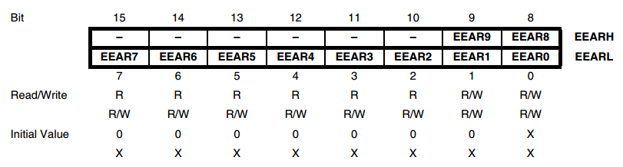
EEPROM address register
EEPROM address register: EEARH and EEARL
Specifies the EEPROM address in the 1024 bytes EEPROM space.
The EEPROM data bytes are addressed linearly between 0 and 1023

Slide 20
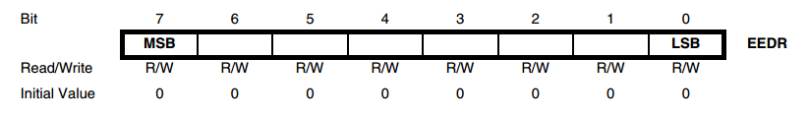
EEPROM Data Register: EEDR
The EEPROM Data Register: EEDR
Contains the data to be written/read

Slide 21
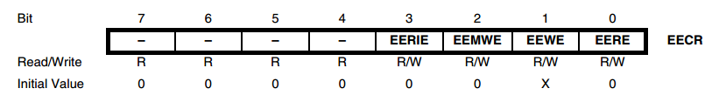
The EEPROM Control Register: EECR
EEMWE: EEPROM Master Write Enable
Must be set to enable write operation
When EEMWE is set, setting EEWE within four clock cycles will write data to the EEPROM
When EEMWE has been written to one by software, hardware clears the bit to zero after four clock cycles

Slide 22
The EEPROM Control Register: EECR
EEWE: EEPROM Write Enable
Signals the write strobe to the EEPROM
When address and data are correctly set up, the EEWE bit must be written to one to write the value into the EEPROM.
The EEMWE bit must be written to one before a logical one is written to EEWE

Slide 23
Steps to write into EEPROM
1. Wait until EEWE becomes zero. 2. Wait until SPMEN in SPMCR becomes zero. (see next slide, not needed in general) 3. Write new EEPROM address to EEAR (optional). 4. Write new EEPROM data to EEDR (optional). 5. Write a logical one to the EEMWE bit while writing a zero to EEWE in EECR. 6. Within four clock cycles after setting EEMWE, write a logical one to EEWE.

Slide 24
Steps to write into EEPROM
The EEPROM can not be programmed during a CPU write to the Flash memory
The software must check that the Flash programming is completed before initiating a new EEPROM write.
Step 2 is only relevant if the software contains a Boot Loader allowing the CPU to program the Flash. If the Flash is never being updated by the CPU, step 2 can be omitted. Which is typically our case

Slide 25
The EEPROM Control Register: EECR
EERE: EEPROM Read Enable
Signals read strobe to the EEPROM
The EERE bit must be written to a logic one to trigger the EEPROM read.
The EEPROM read access takes one instruction
When the EEPROM is read, the CPU is halted for four cycles before the next instruction is executed.
The user should poll the EEWE bit before starting the read operation. If a write operation is in progress, it is neither possible to read the EEPROM, nor to change the EEAR Register.

Slide 26
Write a program to write the characters ‘a’ to ‘z’ in the first 26 bytes of EEPROM

Slide 27
C function
void EEPROM_write(unsigned int uiAddress, unsigned char ucData)
{
/* Wait for completion of previous write */
while(EECR & (1<<EEWE));
/* Set up address and data registers */
EEAR = uiAddress;
EEDR = ucData;
/* Write logical one to EEMWE */
EECR |= (1<<EEMWE);
/* Start eeprom write by setting EEWE */
EECR |= (1<<EEWE);
}

Slide 28
C Code
int main(void)
{
unsigned int uiAddress;
for (uiAddress=0;uiAddress<26;uiAddress++)
{
EEPROM_write(uiAddress,uiAddress+97);
_delay_ms(200);
}
while(1);
}

Slide 29
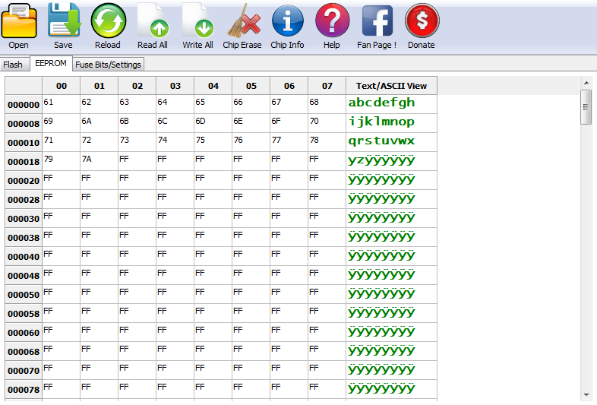
Reading EEPROM Data with Extreme Burner
You need to use “Read All” or “Read EEPROM” options

Slide 30
Writing in EEPROM directly with Extreme Burner
You can edit EEPROM content from the GUI and use “Write EEPROM” option to burn the data

Slide 31
Write a program to convert the first 26 bytes of EEPROM to uppercase letters, if it is a lowercase letter.

Slide 32
EEPROM Read – C Function
unsigned char EEPROM_read(unsigned int uiAddress)
{
/* Wait for completion of previous write */
while(EECR & (1<<EEWE));
/* Set up address register */
EEAR = uiAddress;
/* Start eeprom read by writing EERE */
EECR |= (1<<EERE);
/* Return data from data register */
return EEDR;
}

Slide 33
C Code
int main(void)
{
unsigned int uiAddress;
unsigned char c;
for (uiAddress=0;uiAddress<26;uiAddress++)
{
c = EEPROM_read(uiAddress);
if(c>='a' && c<='z')
EEPROM_write(uiAddress, c+'A'-'a');
_delay_ms(200);
}
while(1);
}

Slide 34
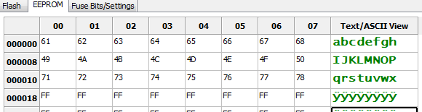
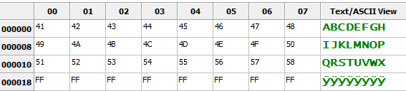
EEPROM Content before and after running the code
BEFORE
AFTER

Slide 35
☺

